Slide 1

Energy Consumption Analysis

Slide 2
About me
Background
B.Tech in Mechanical Engineering from IIT Dharwad
Why Data Science?
Fascinated by the power of data to solve real-world problems across industries
Seeking to transition from traditional mechanical engineering to cutting-edge technology fields
Excited about combining analytical thinking with innovative data-driven solutions
Motivated by data science applications in engineering optimization and Industry 4.0
Work Experience
Fresh graduate - No professional work experience yet
Ready to apply strong analytical foundation from engineering background
Connect with Me On:
LinkedIn: https://www.linkedin.com/in/thota-maniram/
GitHub: https://github.com/maniram3112

Slide 3
Objective of the Project
Database Creation & Integration
Create a structured SQL database from multiple CSV datasets.
Import and integrate data into tables for GDP, Emissions, Population, Production, Consumption, and Country.
Establish relationships between tables using ER diagram principles (Country → Emissions, Population, Production, Consumption, GDP).
Data Cleaning & Structuring
Ensure consistent keys (country, year) across all datasets.
Build a relational schema to support multi-dimensional analysis.
Analytical Goals
Perform General & Comparative Analysis (e.g., top emitters, GDP leaders, energy comparisons).
Conduct Trend Analysis Over Time (GDP growth, emissions change, population impact).
Carry out Ratio & Per Capita Analysis (emission-to-GDP, energy per capita, efficiency ratios).
Explore Global Comparisons (top populations vs emissions, global averages, emission shares).
Business Insights
Identify countries showing efficient growth with lower emissions.
Provide data-backed recommendations for policymakers and researchers.
Skill Development & Challenges
Gain hands-on experience in SQL query design and optimization.
Learn how to approach multiple solutions for a single question.
Build reasoning skills to justify chosen methodologies.

Slide 4
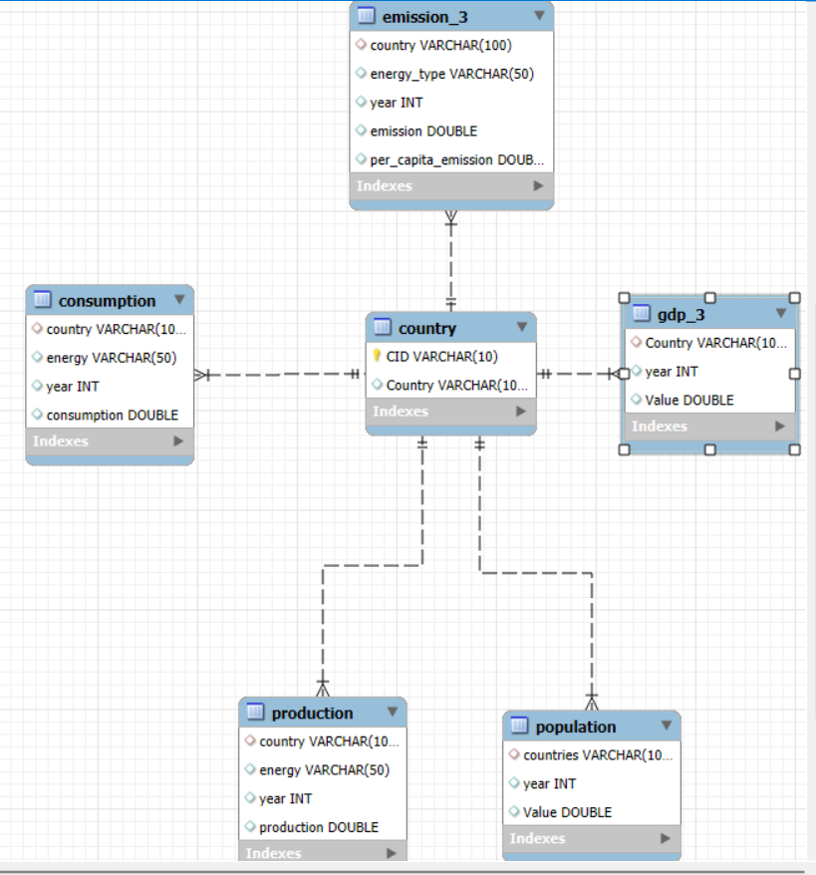
ER Diagram & Schema Highlights
Main Entities (Tables):
Emissions → tracks total CO₂ emissions & per capita emissions.
GDP → stores yearly Gross Domestic Product values.
Population → maintains total population of each country per year.
Common Keys:
Country and Year are the linking attributes across all three tables.
They ensure consistency when joining datasets for analysis.
Attributes:
Emissions table: emission, emission_per_capita
GDP table: gdp_value
Population table: population
Primary Keys & Relationships:
(country, year) → composite primary key in each table.
Acts as foreign keys when joining across tables.
Schema Design Benefits:
Supports multi-year comparative analysis.
Enables calculating ratios like emission-to-GDP, emission-per-capita.
Allows global aggregation (summing across all countries).
Facilitates trend analysis (country-wise & year-wise).

Slide 5
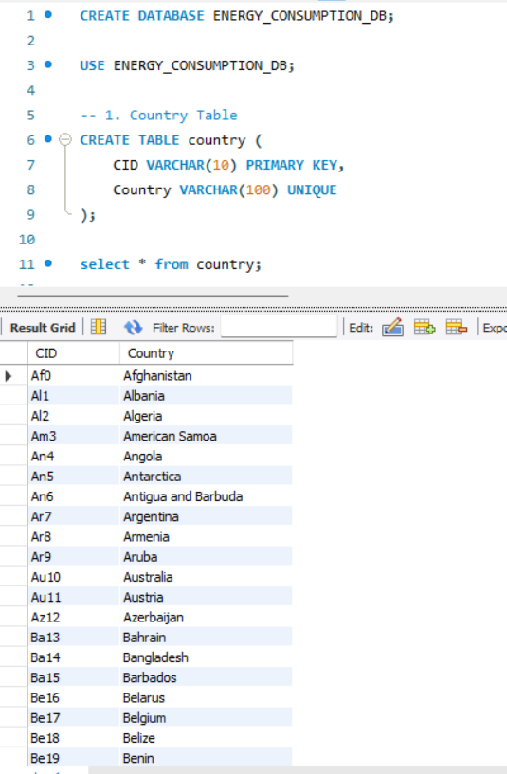
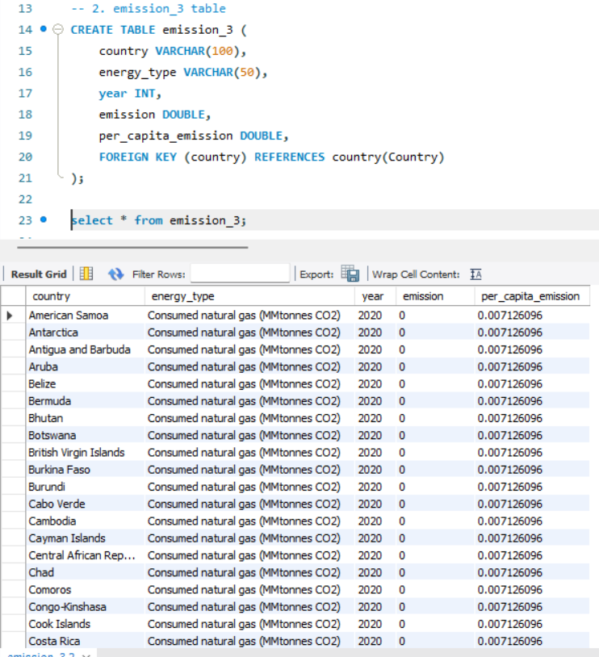
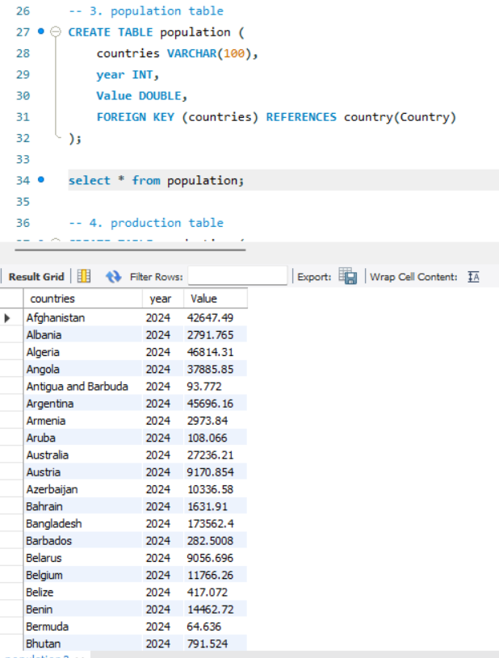
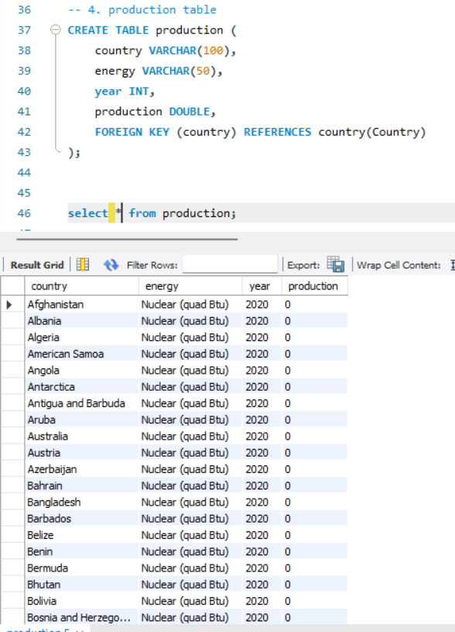
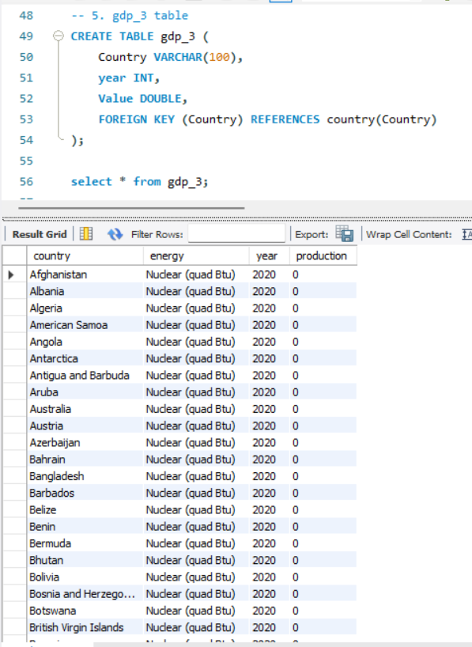
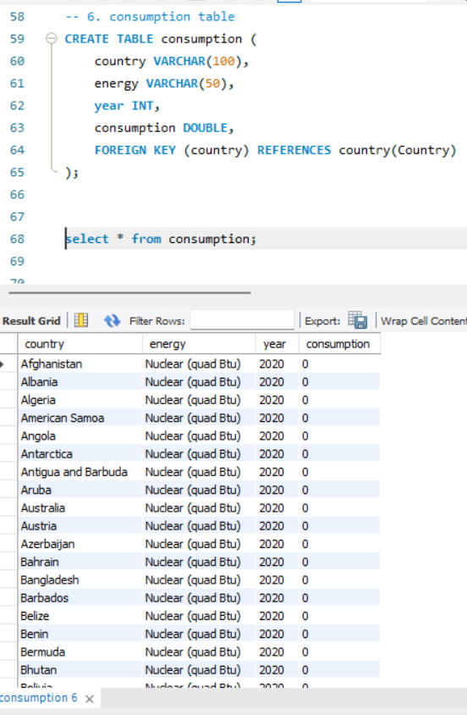
Country Table
Emission Table
Population Table
Production Table
GDP Table
Consumption Table

Slide 6
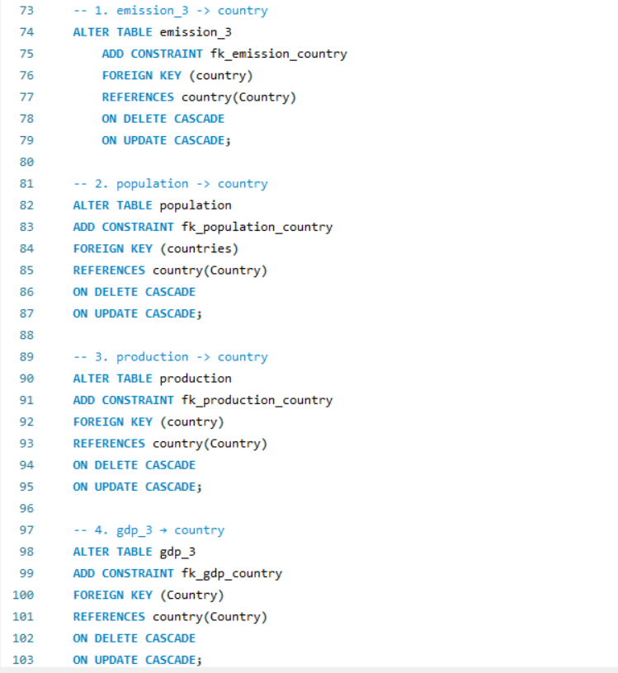
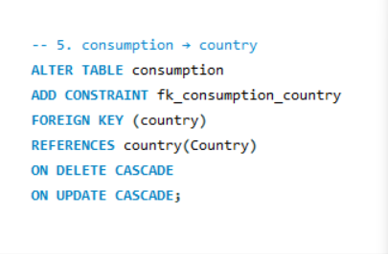
Relationships

Slide 7
Key Analysis Questions (Use Cases)
We analysed the dataset using SQL queries to answer the following questions:
A. Emissions & Economy
What is the total emission per country for the most recent year available? → Identified top emitters and their contribution to global share.
What are the top 5 countries by GDP in the most recent year? → Highlighted leading economies and compared their emission efficiency.
What is the emission-to-GDP ratio for each country by year? → Tracked efficient vs. inefficient economies.
Which countries show high GDP but low emissions (efficient economies)? → Examples: (You can add actual country names from your results).
B. Energy Production & Consumption
Compare energy production and consumption by country and year. → Detected energy deficit/surplus countries.
Which energy types contribute most to emissions across all countries? → Identified top contributors (e.g., coal, oil).
What is the energy consumption per capita for each country? → Helped compare living standards and sustainability.

Slide 8
C. Trend Analysis Over Time
How have global emissions changed year over year? → Found upward/downward trends.
What is the trend in GDP for each country over the given years? → Linked with emission growth/decline.
How has population growth affected total emissions in each country? → Observed stronger growth in developing nations.
Has energy consumption increased or decreased for major economies? → Growth trend visible for industrial economies.
What is the average yearly change in emissions per capita? → Used to rank countries on sustainability.
D. Global Comparisons
What are the top 10 countries by population and how do their emissions compare? → Compared population vs. emission contribution.
Which countries have reduced their per capita emissions the most over the last decade? → Highlighted progress in renewable adoption.
What is the global share (%) of emissions by country? → Created pie charts to show distribution.
What is the global average GDP, emission, and population by year? → Provided a macro-level benchmark.

Slide 9
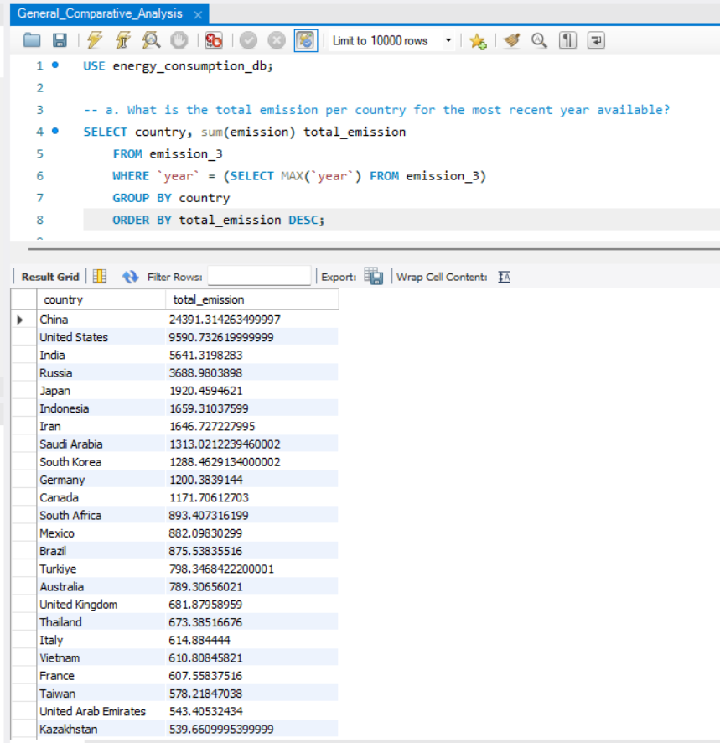
General Comparative Analysis
Q1. What is the total emissions per country for the most recent year available?

Slide 10
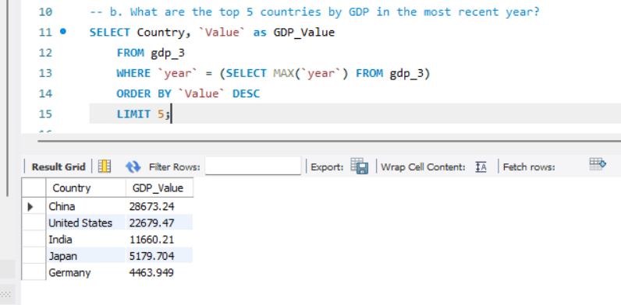
Q2. What are the top 5 countries by GDP in the most recent year?

Slide 11
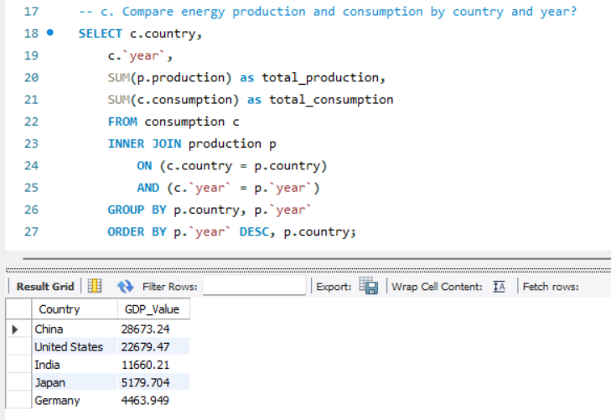
Q3. Compare energy production and consumption by country and year?

Slide 12
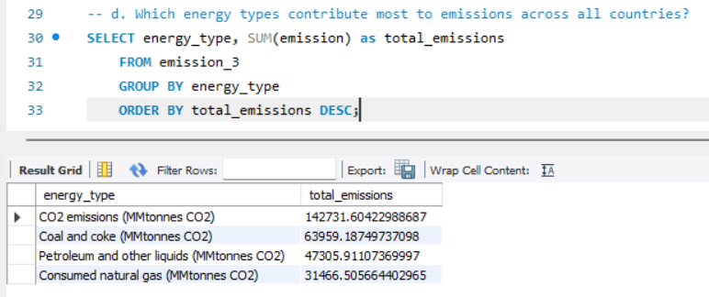
Q4. Which energy types contribute most to emissions across all countries?

Slide 13
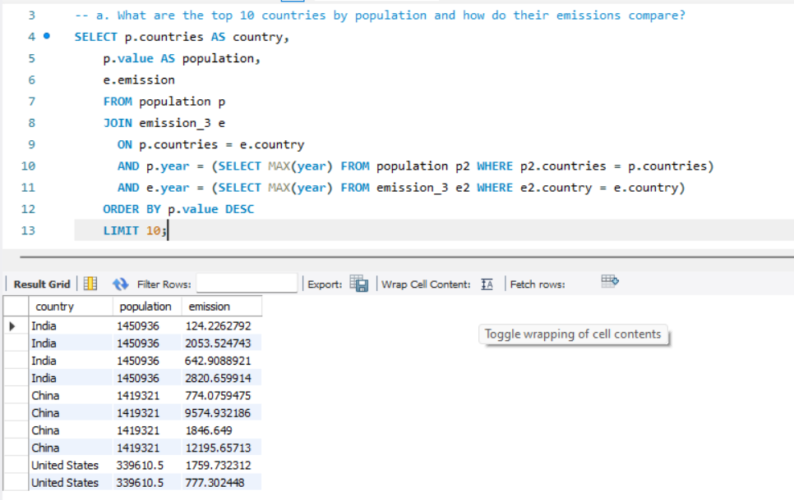
Global Comparision Analysis
Q1. What are the top 10 countries by population and how do their emissions compare?

Slide 14
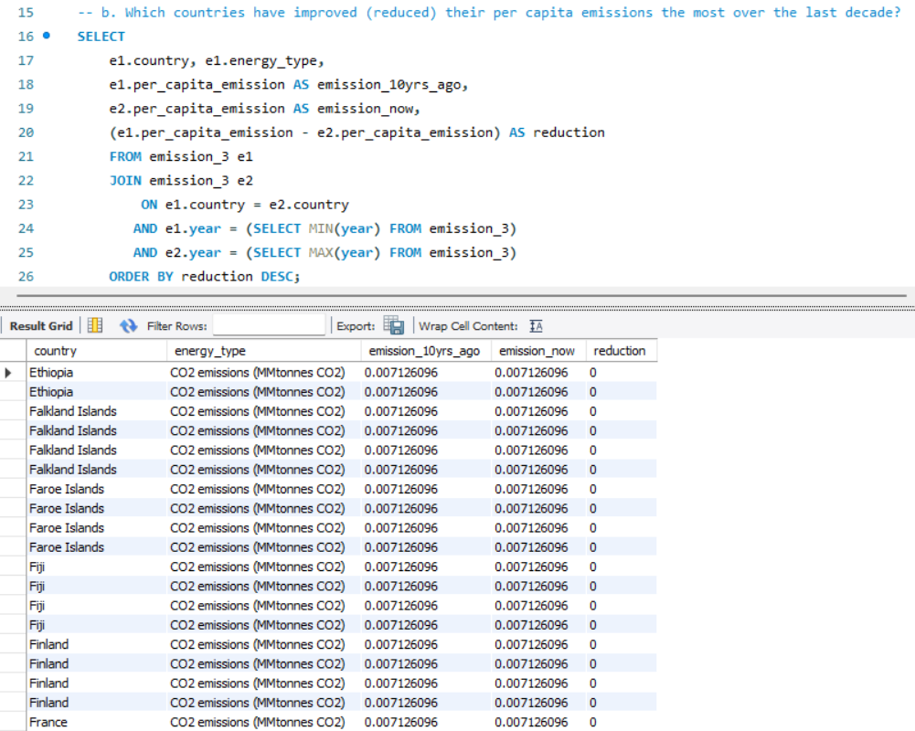
Q2. Which countries have improved(reduced) their per capita emissions the most the over the last decade?

Slide 15
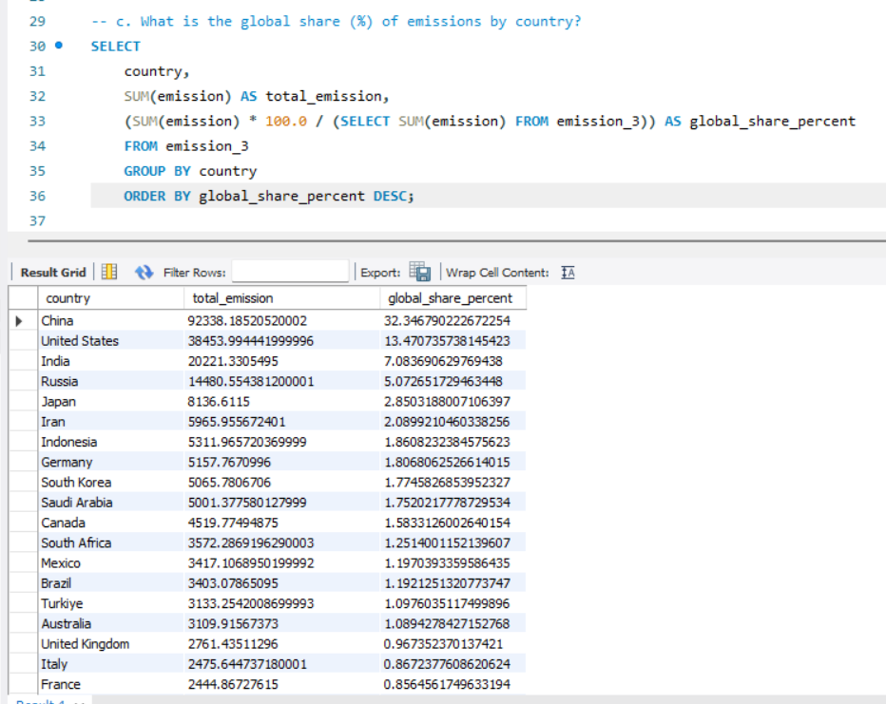
Q3. What is the global share (%) of emissions by countries?

Slide 16
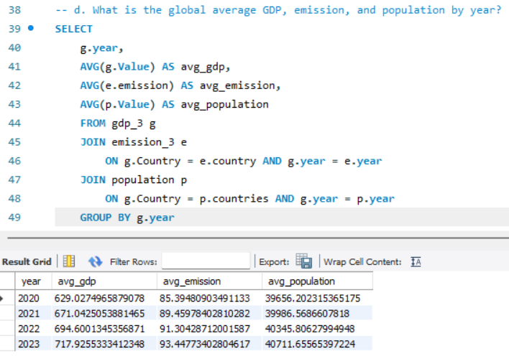
Q4. What is the global average GDP, emission, and population by year?

Slide 17
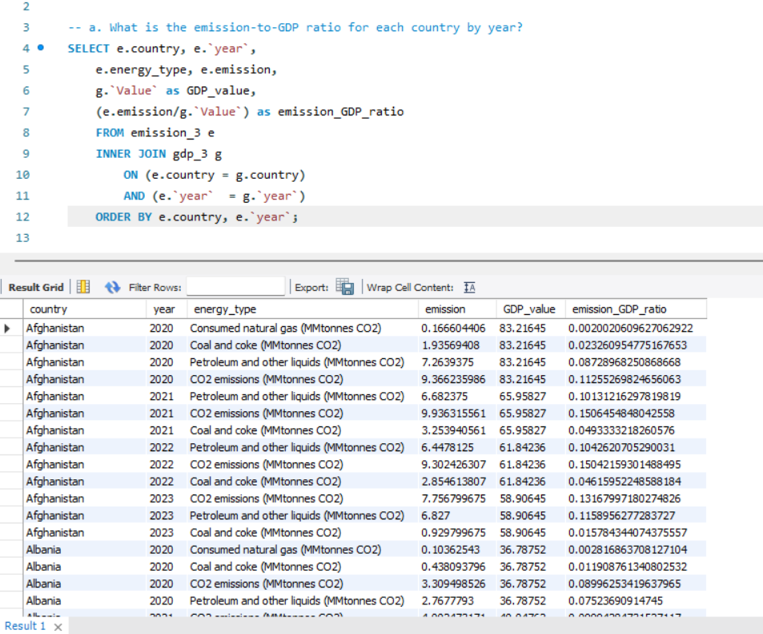
Ratios & Per Capita Analysis
Q1. What is the emission-to-GDP ratio for each country by year?

Slide 18
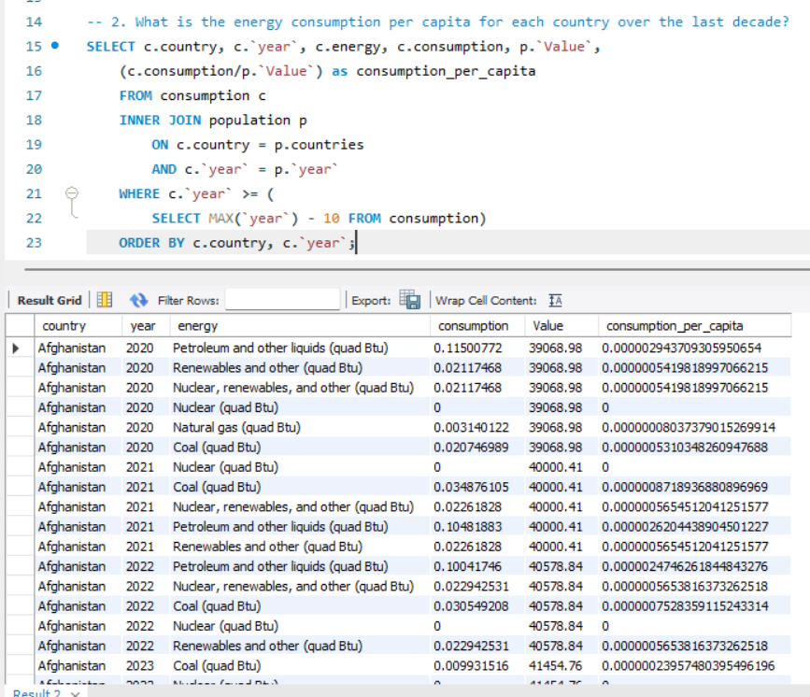
Q2. What is the energy consumption per capita for each country over the last decade?

Slide 19
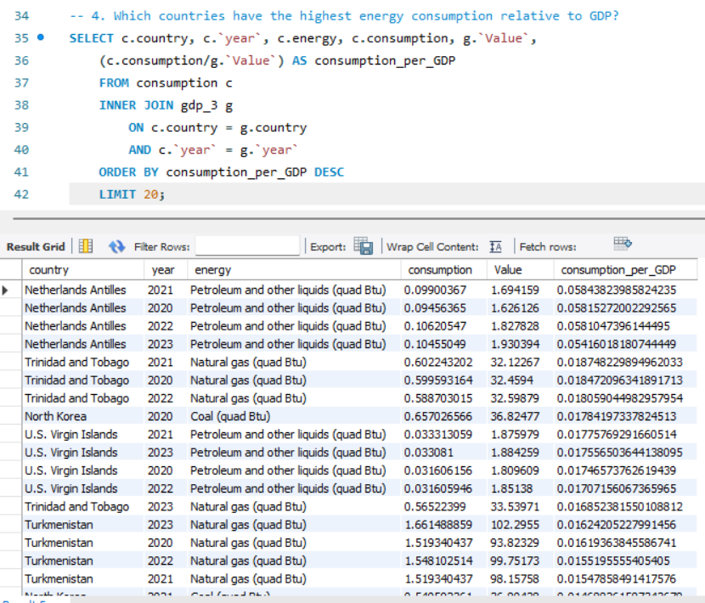
Q4. Which countries have the highest energy consumption relative to GDP?

Slide 20
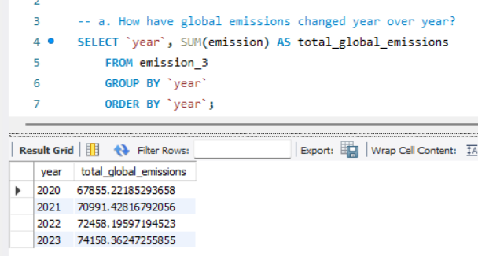
Trend Analysis
Q1. How have global emissions changes year over year?

Slide 21
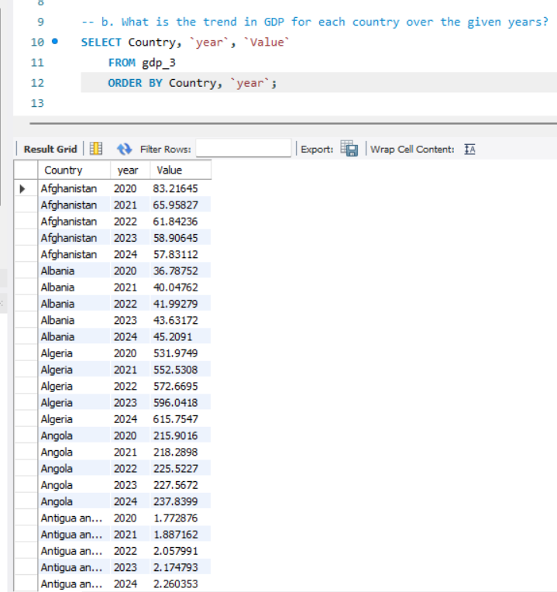
Q2. What is the trend in GDP for each country over years?

Slide 22
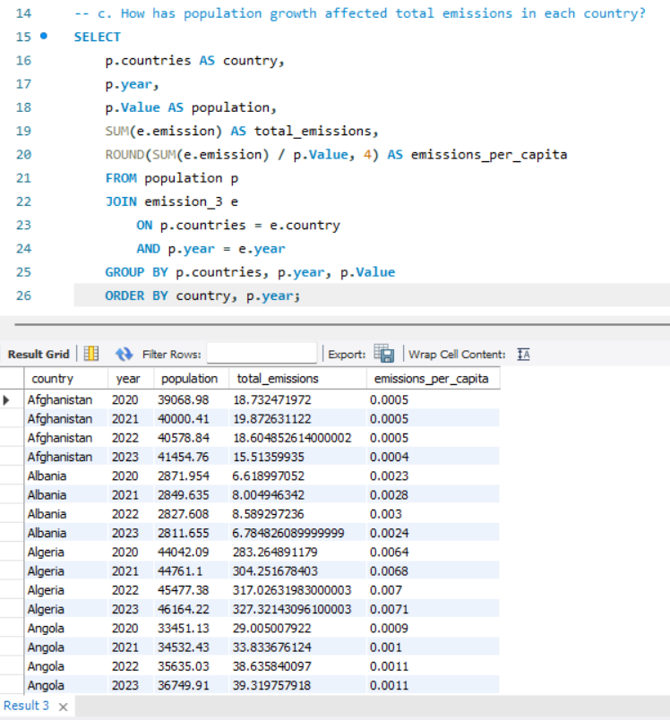
Q3. How has population growth affectected total emissions in each country?

Slide 23
Final Business Insights
Top Reducers Identified
Countries with the highest positive reduction values have successfully lowered per capita emissions.
Likely due to transition to renewables, stricter regulations, energy efficiency programs, or adoption of cleaner technologies.
Emission Increasers
Countries showing negative reduction (increase) are experiencing rising per capita emissions.
Common reasons: industrial expansion, urbanization, reliance on coal/oil, or weak enforcement of climate policies.
Energy Type Differences
Breakdown by energy_type shows which sectors contribute most to reduction (e.g., renewables) vs increase (e.g., coal/oil).
Provides a sectoral lens for targeted interventions.
Developed vs Developing Trends
Many developed economies tend to show reductions (due to decarbonization).
Several developing economies may still be increasing emissions as they industrialize, despite green pledges.
Per Capita vs Absolute Emissions
Even if per capita emissions dropped, population growth in some countries might offset total reductions.
Need to analyze alongside absolute emissions for a complete picture.

Slide 24
Business Recommendations
Policy Reinforcement
Countries with high reductions → continue incentives for renewables, EVs, and green tech.
Countries with increases → implement stricter carbon pricing, pollution taxes, and regulatory frameworks.
Targeted Energy Transition
Focus on phasing out coal and replacing it with natural gas, solar, and wind.
Encourage public-private partnerships for renewable infrastructure.
Technology Adoption
Invest in carbon capture, smart grids, energy-efficient manufacturing.
Promote innovation in storage (batteries, hydrogen) to stabilize renewable adoption.
Global Collaboration
Developed nations should support developing ones with green financing, technology transfer, and capacity building.
Regional agreements can help synchronize emission reduction goals.
Business Opportunities
Expanding markets in renewables, EVs, sustainable manufacturing, and carbon credits.
Companies can gain a competitive advantage by aligning with net-zero commitments.

Slide 25
Conclusion – Key Findings Overall
Global Emissions Growth:
Emissions have generally increased over the years, though growth rates vary by country and region. Emerging economies show higher growth, while some developed economies show stabilization or decline.
Emission-to-GDP Ratio Declining:
Many advanced economies demonstrate lower emission intensity, indicating improved efficiency and cleaner energy adoption.
High GDP, Low Emissions:
Countries like Germany, Japan, and France achieve strong economic performance with relatively lower emissions due to efficiency and renewable energy use.
High Emissions per Capita:
Oil-rich and highly industrialized countries (e.g., USA, Australia, Middle East nations) record disproportionately high emissions per person.
Population Trends Impact:
Large population countries like India and China contribute significantly to total emissions, though per capita levels remain lower compared to developed nations.
Energy Mix Influence:
Fossil fuels remain the largest contributors to emissions, while renewables are growing but still insufficient to offset overall global demand.
Top Contributors:
A small set of countries (China, USA, India, Russia, Japan) dominate global emissions, while many smaller economies have minimal contribution.

Slide 26


Q&A

Slide 27
Experience & Challenges in SQL Data Analysis Project
Experience Gained:
Strengthened SQL query writing skills (Joins, Group By, Subqueries).
Improved data cleaning and transformation techniques.
Learned to generate business insights from raw datasets.
Hands-on practice with real-world datasets (emissions, GDP, population).
Enhanced ability to link data analysis with decision-making.
Challenges Faced & Overcome:
Handling inconsistent data (null values, mismatched years/countries).
Optimizing complex queries for performance.
Understanding business questions and translating them into SQL queries.
Visualizing data beyond SQL outputs (exporting to Excel/Power BI for clarity).
Balancing accuracy vs. readability of SQL queries.

Slide 28

THANK YOU

